Slide 1
Class in JavaScript

Slide 2
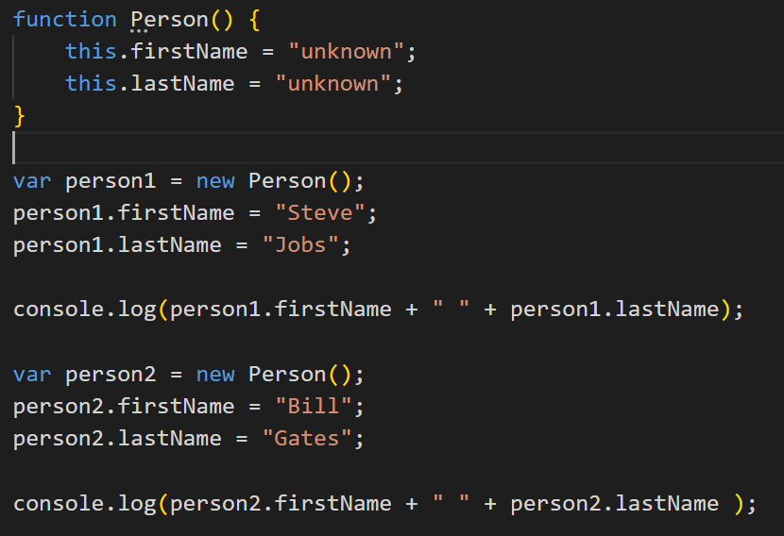
Class in JavaScript
JavaScript ECMAScript 5, does not have class type.
So it does not support full object oriented programming concept as other languages like Java or C#.
However, you can create a function in such a way so that it will act as a class.

Slide 3
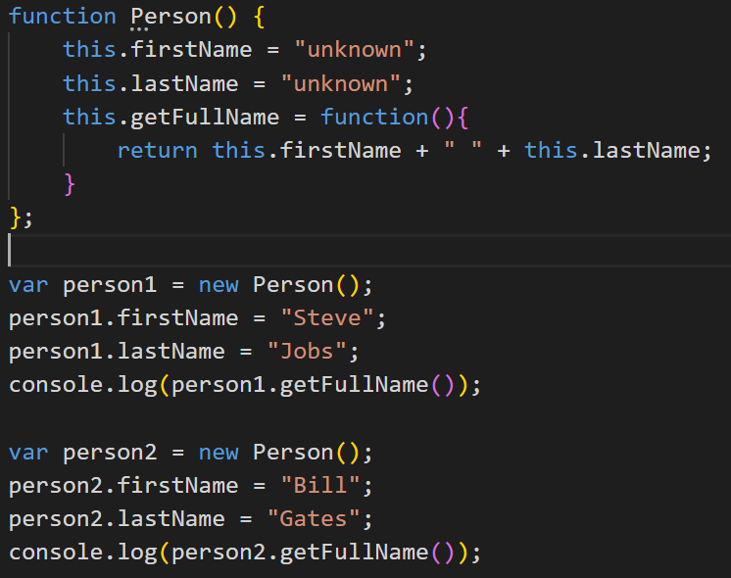
Add Methods in a Class
We can add a function expression as a member variable in a function in JavaScript.
This function expression will act like a method of class.

Slide 4
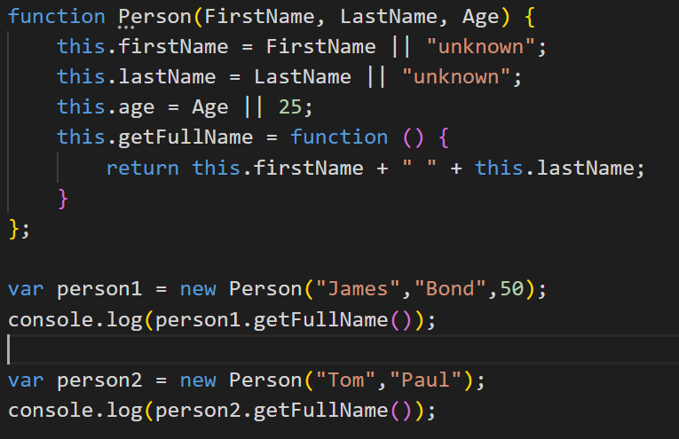
Constructor
In JavaScript, a function can have one or more parameters.
So, a function with one or more parameters can be used like a constructor where you can pass parameter values at the time or creating an object with new keyword.

Slide 5
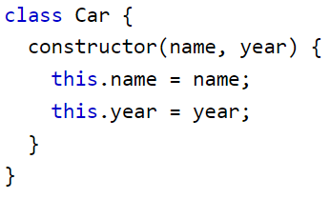
JavaScript Classes
ECMAScript 2015, also known as ES6, introduced JavaScript Classes.
JavaScript Classes are templates for JavaScript Objects.
Use the keyword class to create a class.
Always add a method named constructor()
A JavaScript class is not an object.
It is a template for JavaScript objects.

Slide 6
The Constructor Method
The constructor method is a special method:
It has to have the exact name "constructor"
It is executed automatically when a new object is created
It is used to initialize object properties
If you do not define a constructor method, JavaScript will add an empty constructor method.

